Slide 1
Azure DevOps
Shawn Weisfeld
Sr. Cloud Solution Architect
Microsoft

Slide 2




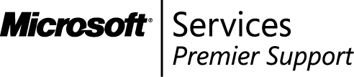

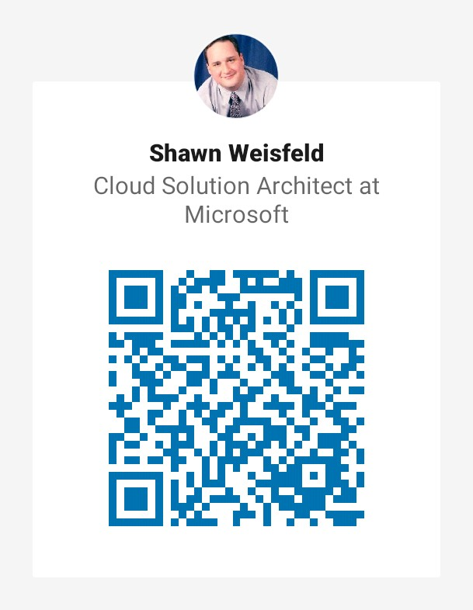
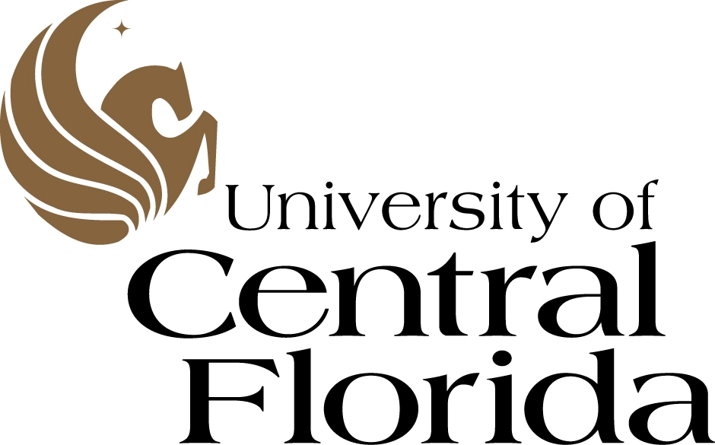











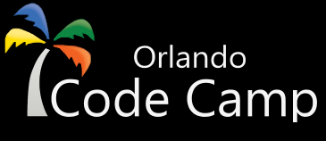
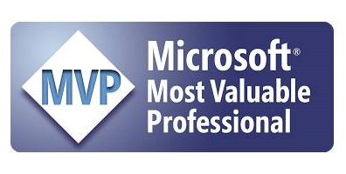
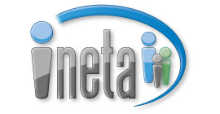

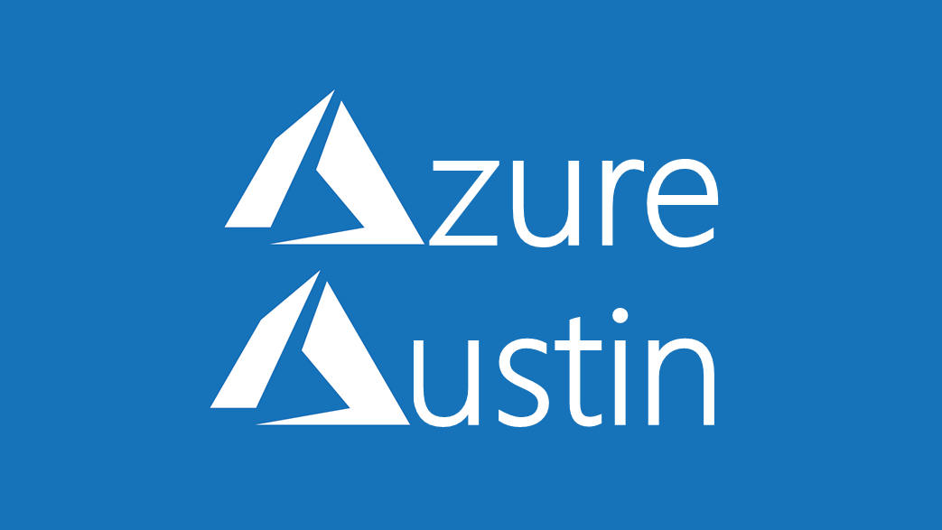

Slide 3
WHAT IS DEVOPS?
(i.e. the process, dev tools and cloud vendor/deployment target agnostic)

Slide 4

What is DevOps?
“Development and operations collaboration”
“Automation”
“Faster and smaller releases”
“A job title”
Notes:
So, what is DevOps exactly?
DevOps is a term for a group of concepts that, while not all new, have catalyzed into a movement and are rapidly spreading.
Like any new and popular term, people have different and sometimes contradictory perceptions of what it is.
Currently, DevOps is more like a philosophical movement, and not yet a precise collection of practices, descriptive or prescriptive (e.g., CMM-I, ITIL, Agile, etc.).
In his book The Phoenix Project, Gene Kim, an important DevOps influencer, describes a model how an IT organization can transition to a DevOps model to facilitate fast, rapid, reliable flow of features into production and, ultimately, into the hands of users.

Slide 5
What is DevOps?
People. Process. Products.
Build& Test
Deploy
DevOps is the union of people, process, and products to enable continuous delivery of value to your end users.
“
Continuous Delivery
Develop
Operate
”
Plan & Track
Monitor & Learn

Slide 6
Regardless of what DevOps tools or development language you pick the Microsoft Cloud Platform is here to help!

Slide 7
Azure is just where the Azure DevOps Service runs. The tool facilitates deploying wherever makes sense for your project.

Slide 8





Deliver
with Azure DevOps
Azure Boards
Azure Repos
Azure Pipelines
Azure Artifacts
Azure Test Plans

Slide 9
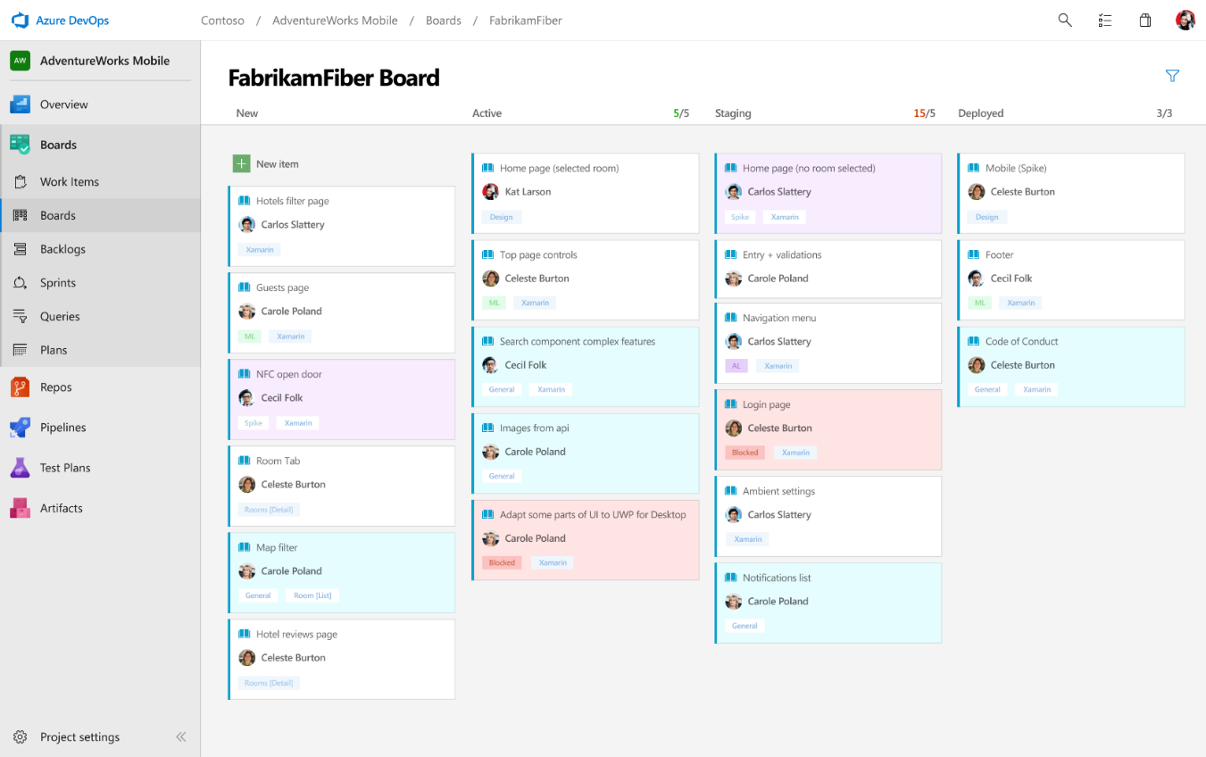
Boards
Azure Boards
Azure Repos
Azure Pipelines
Connecting ideas to releases
Scrum ready to help your teams run sprints, stand-ups, and plan work
Integrated with GitHub commits and pull requests
Insights into project status and health
Azure Artifacts
Azure Test Plans

Slide 10
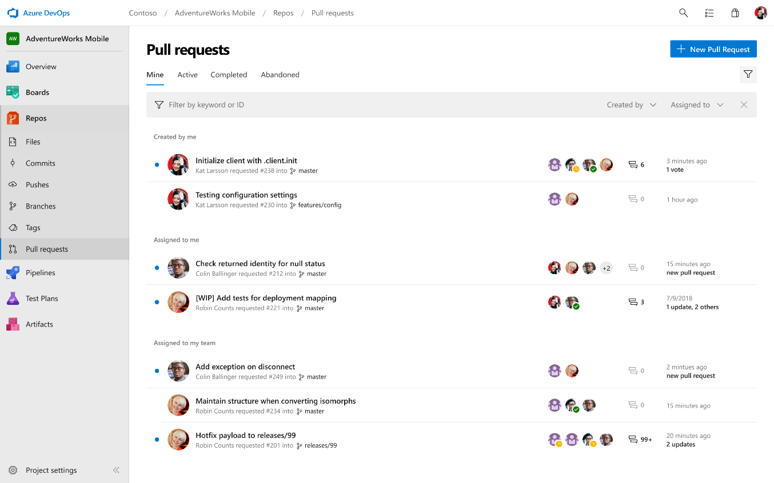
Repos
Azure Boards
Azure Repos
Azure Pipelines
Private Git and TFVC repos for your teams
Code review via branch pull requests
Branch policies and build validation
Easy migration path to / from GitHub
Azure Artifacts
Azure Test Plans

Slide 11
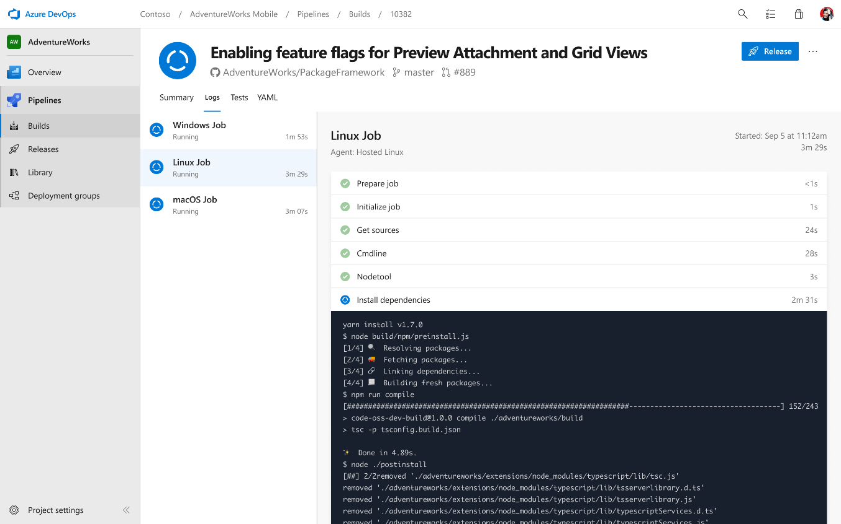
Pipelines: Build
Azure Boards
Azure Repos
Azure Pipelines
Cloud-hosted pipelines for Linux, macOS and Windows
Any language, any platform, any cloud
Native support for containers and Kubernetes
Best-in-class for open source
Azure Artifacts
Azure Test Plans

Slide 12
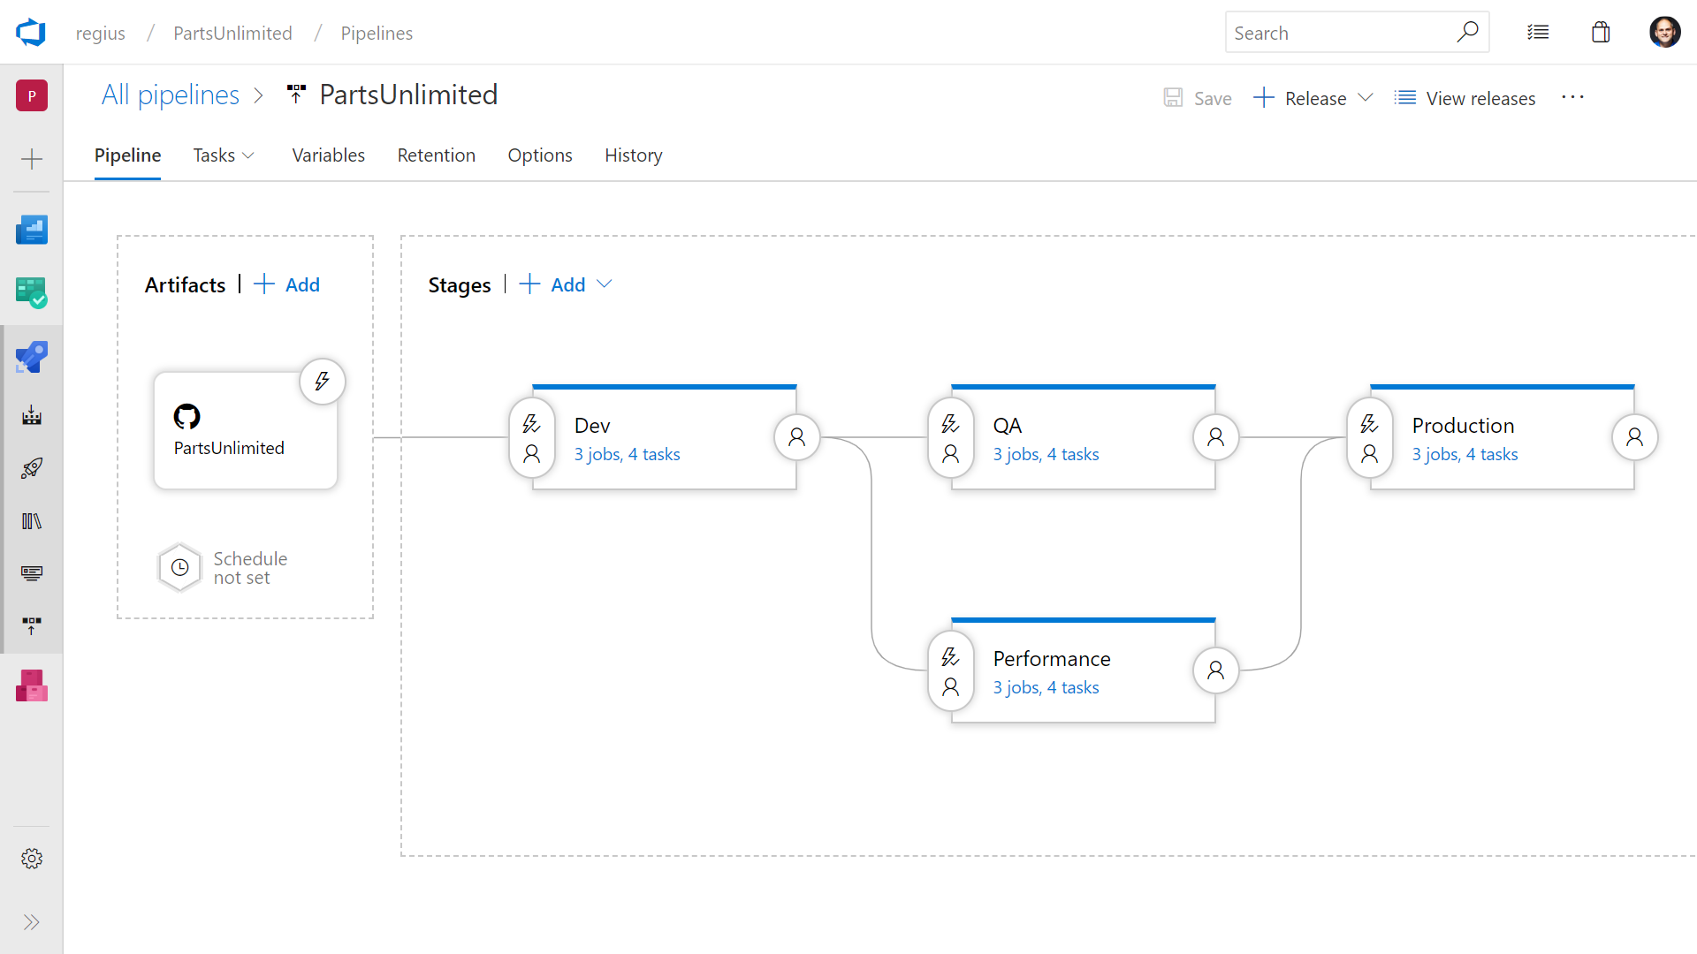
Pipelines: Release
Azure Boards
Azure Repos
Azure Pipelines
Deploy to on-premises, ANY cloud or a hybrid of cloud and on-prem
Staged environment releases
Pre and post deployment approvals with gates to automate approval based on conditions
Azure Artifacts
Azure Test Plans

Slide 13
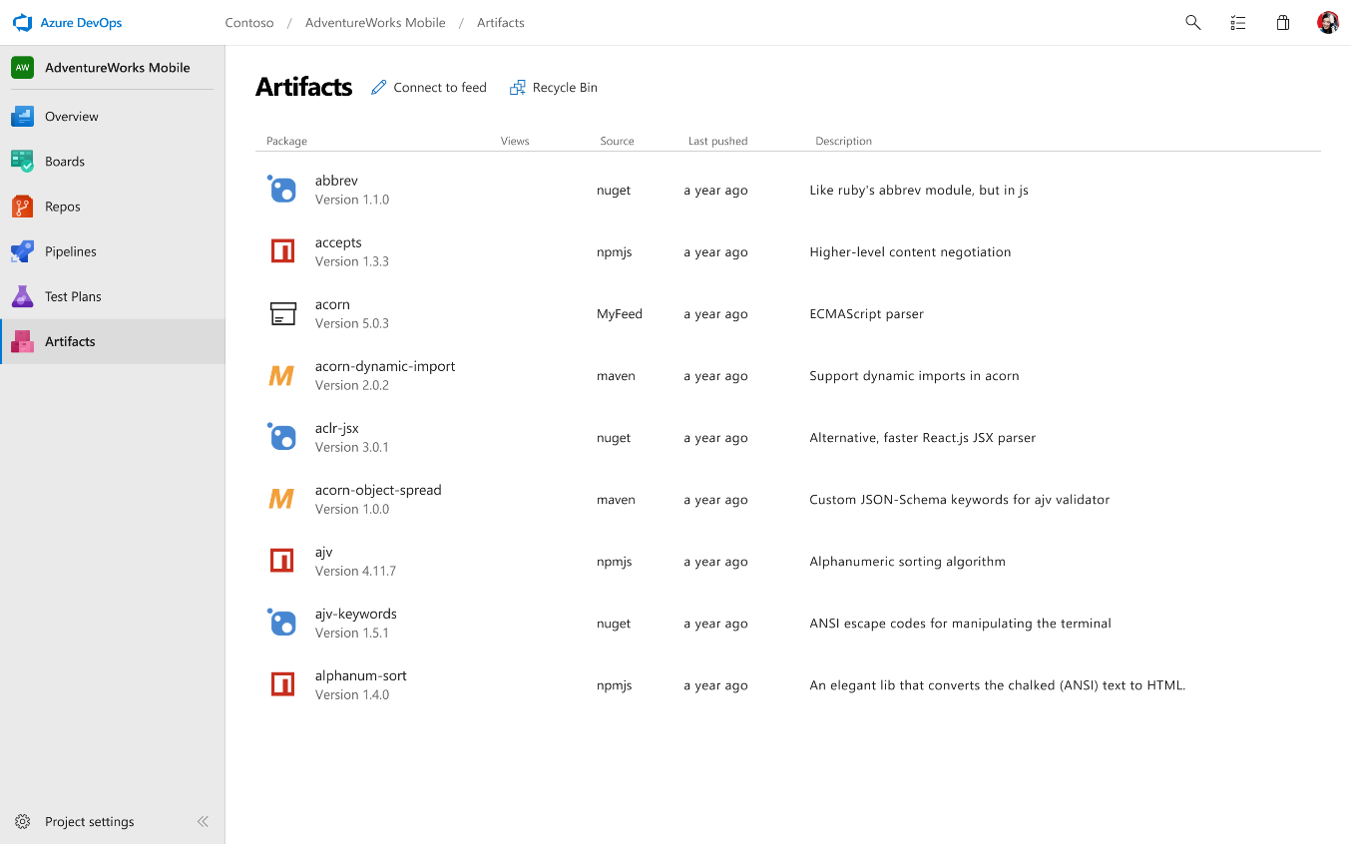
Artifacts
Azure Boards
Azure Repos
Azure Pipelines
Share code efficiently
Keep your Maven, npm, NuGet and Python packages and more in the same place
Aggregate from public registries and internal teams
Publish and track from any pipeline
Azure Artifacts
Azure Test Plans

Slide 14
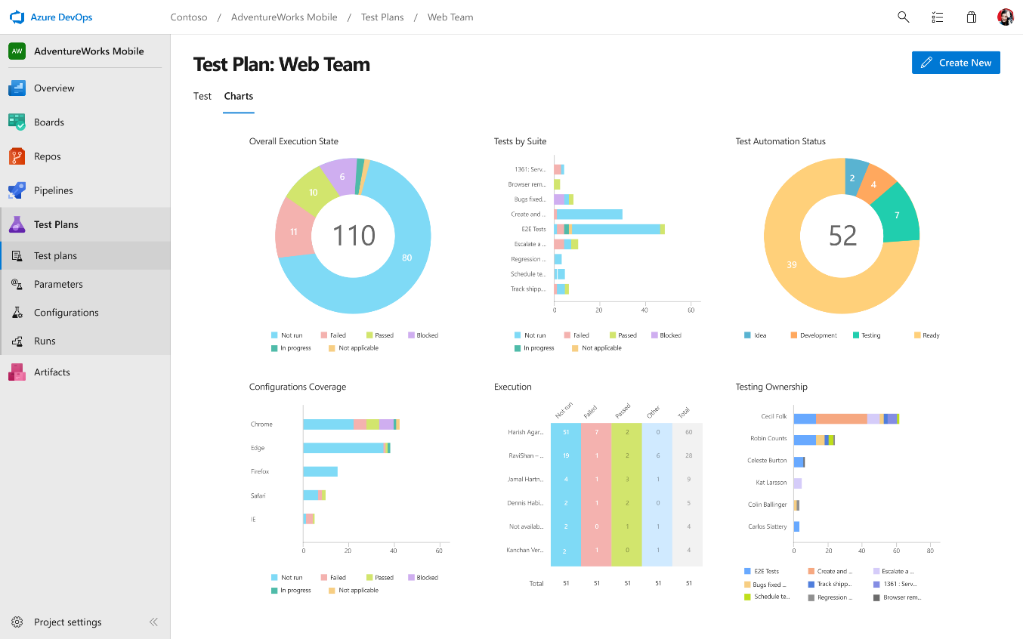
Test Plans
Azure Boards
Azure Repos
Azure Pipelines
Run tests and log defects from your browser
Track and assess quality throughout your lifecycle
Capture rich data for reproducibility
Create tests directly from exploratory sessions
Azure Artifacts
Azure Test Plans

Slide 15
The DevOps tool suite is not all or nothing, use the entire suite, or pick and choose what make sense for your team.

Slide 16



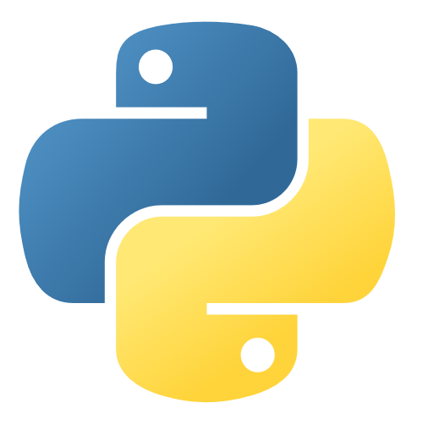
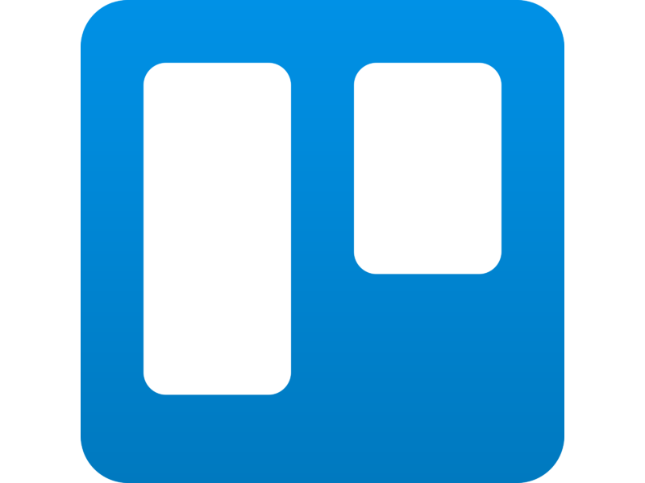


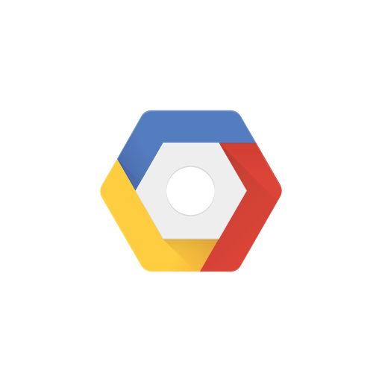

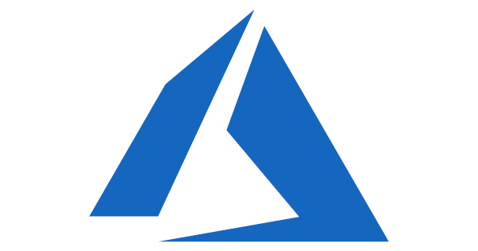

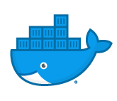
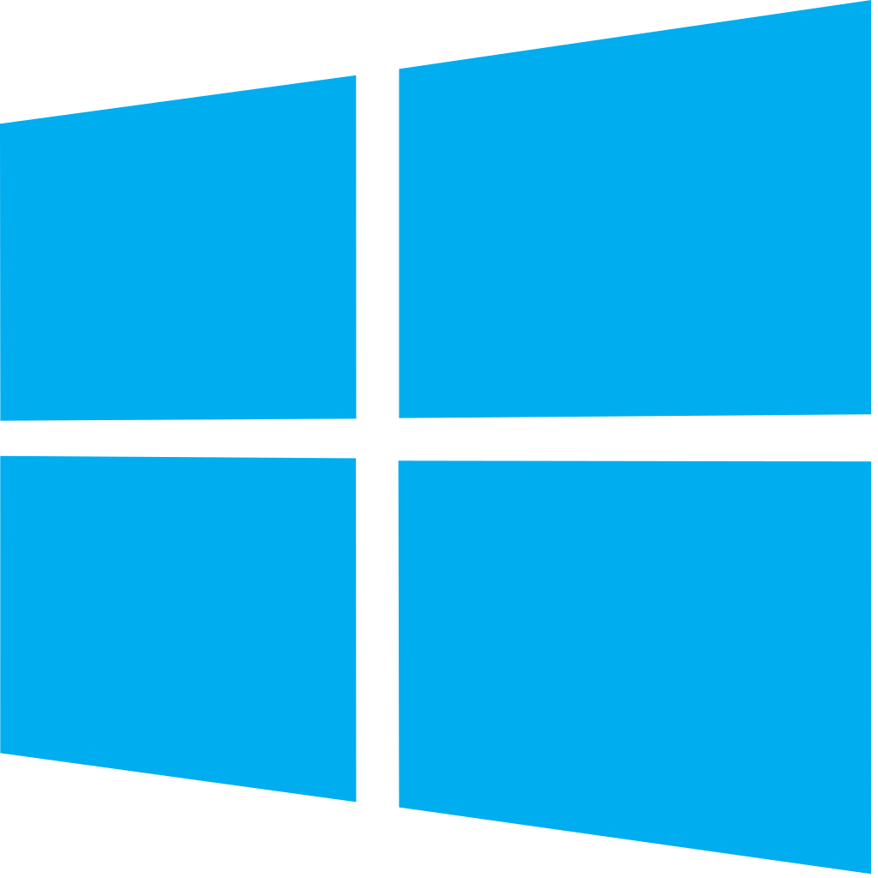


Azure DevOps: Choose what you love
Any Language, Any Platform
Azure DevOps lets developers choose the tools and languages that are right for them
Mix and match to create workflows with tools from Microsoft, open source or your favorite 3rd party tools
Target any cloud, on-prem or both and deploy to the servers you need

Slide 17
Tech use case details & architecture

Slide 18
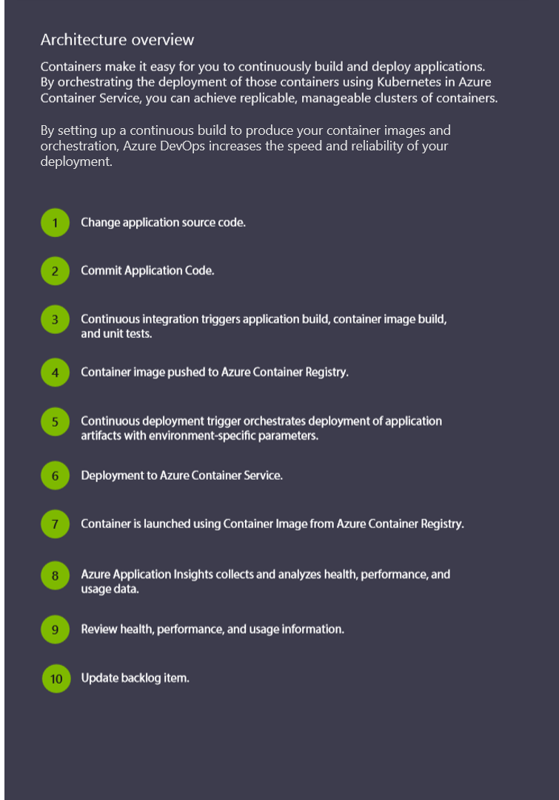
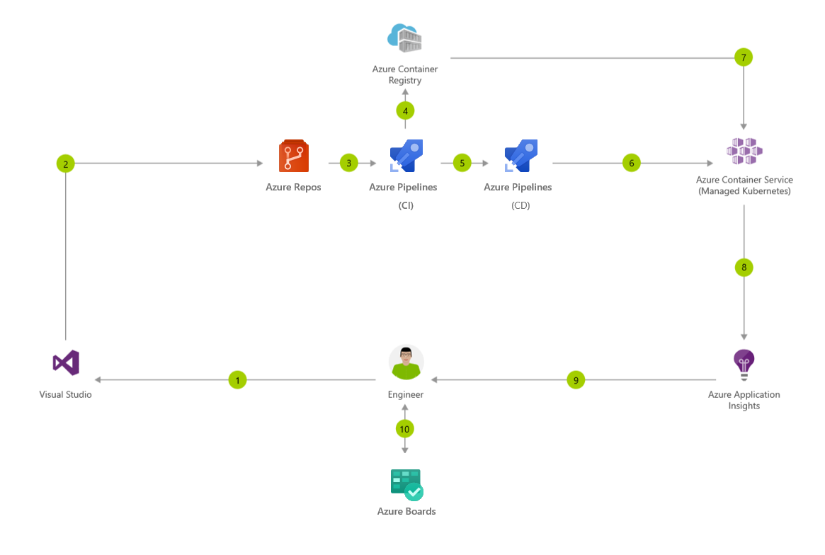
CI/CD for Containers

Slide 19
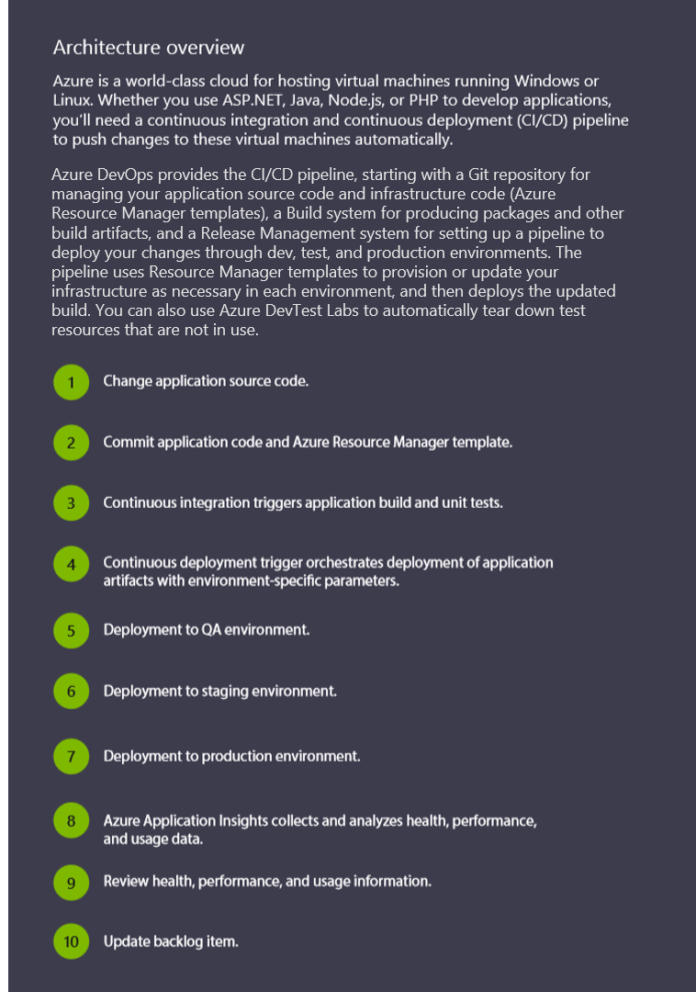
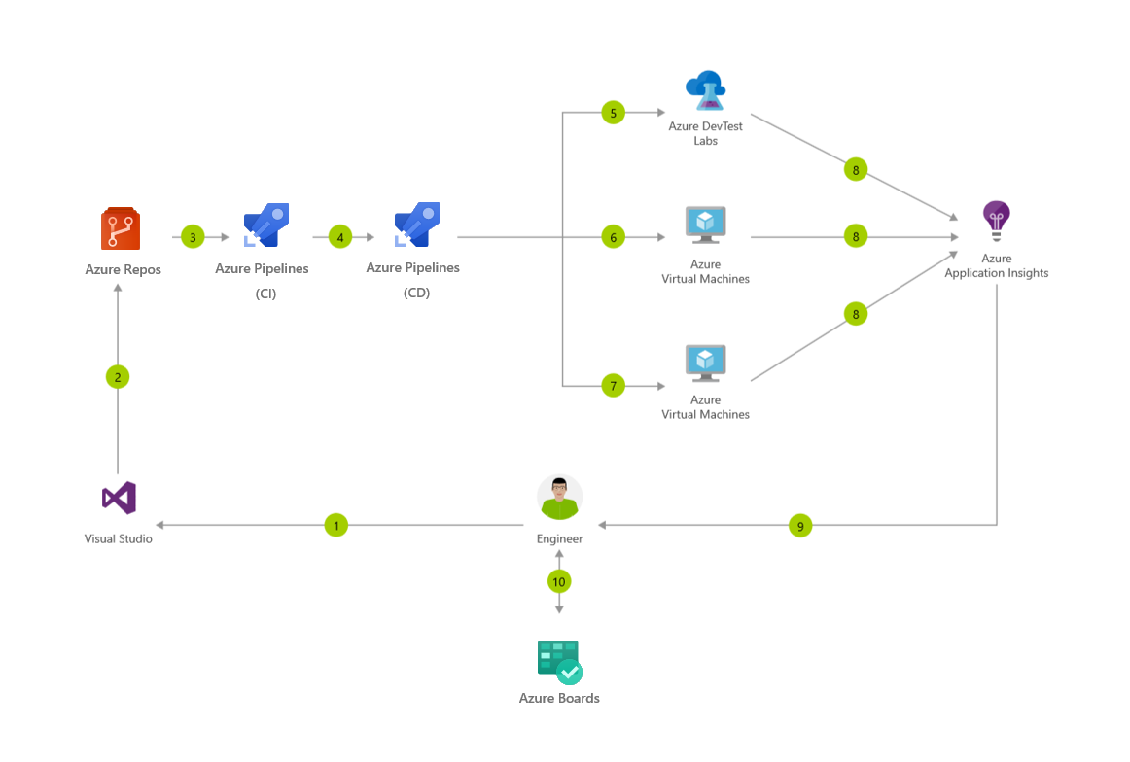
CI/CD for Azure Virtual Machines

Slide 20
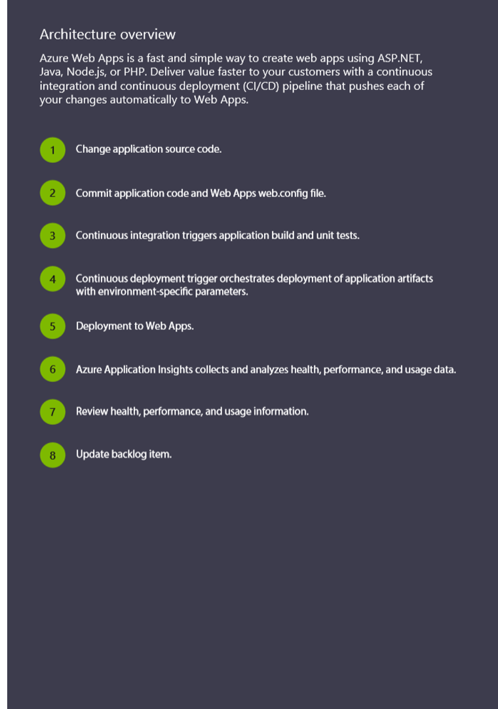
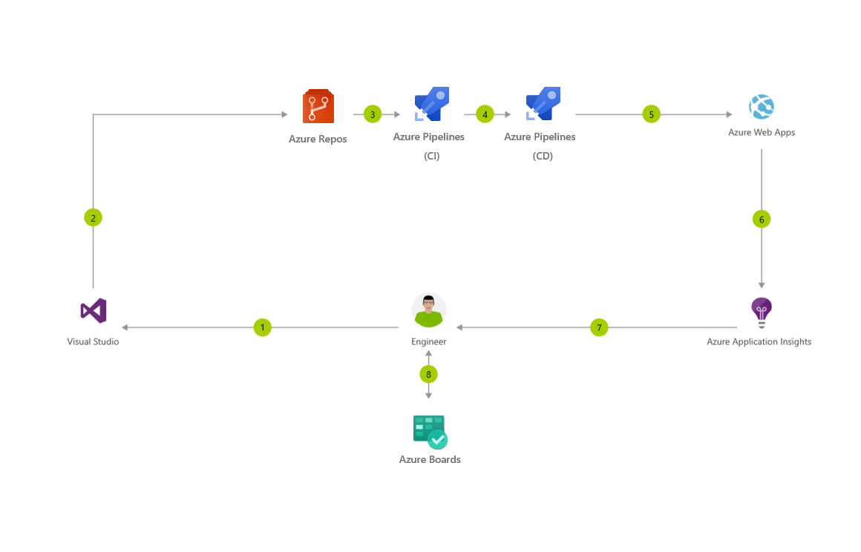
CI/CD for Azure Web Apps

Slide 21
Demo
Notes:
Demo : dev.azure.com

Slide 22
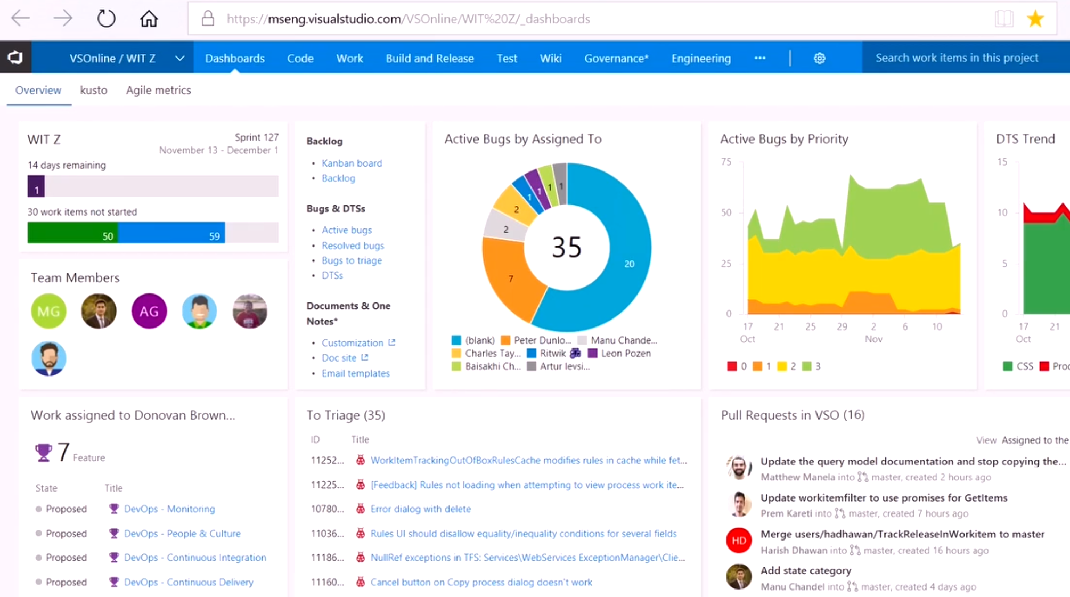
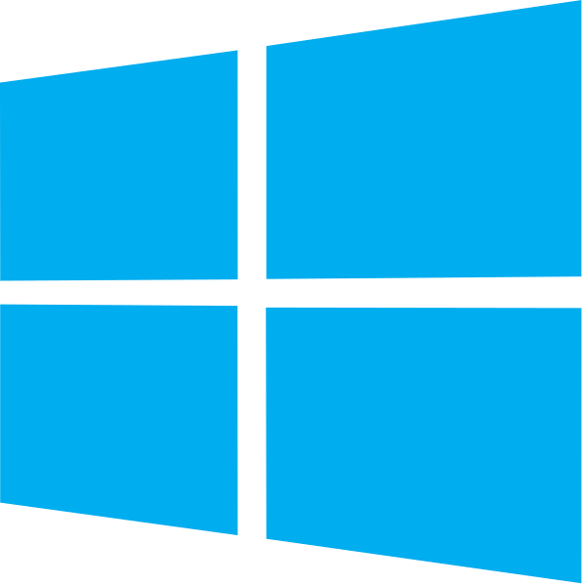

DevOps at Microsoft
DevOps at Scale
Visual Studio Team Services is the toolchain of choice for Microsoft engineering
+85,000
Engineers at Microsoft are using VSTS
Windows Engineering Team
VSTS Engineering Team
VSTS scales to host the world’s largest Git repo
Embracing DevOps practices = More value to customers
300GB Source code
More features delivered to customers in 2016 than in previous 4 years combined
3.5M Files
4,000+ Devs
http://aka.ms/devopsatmicrosoft

Slide 23
Resources
Azure DevOps YouTube Channel – See It
https://www.youtube.com/channel/UC-ikyViYMM69joIAv7dlMsA
Azure DevOps Hands-On Labs – Do It
https://www.azuredevopslabs.com/
Azure DevOps Documentation – Read about It
https://docs.microsoft.com/en-us/azure/devops
Azure DevOps Projects- Get Started Fast
https://azure.microsoft.com/en-us/features/devops-projects/

Slide 24
















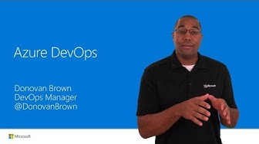



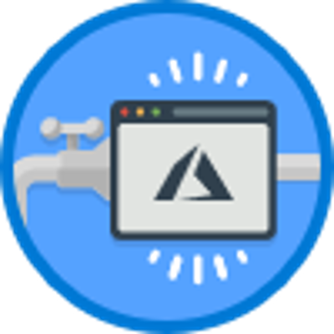
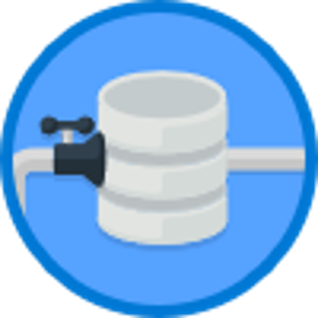

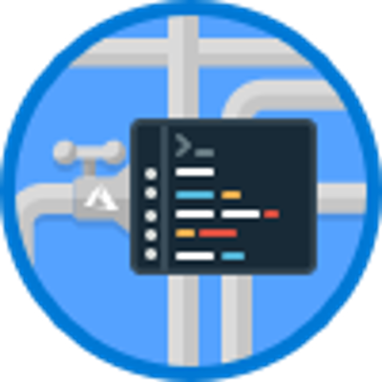

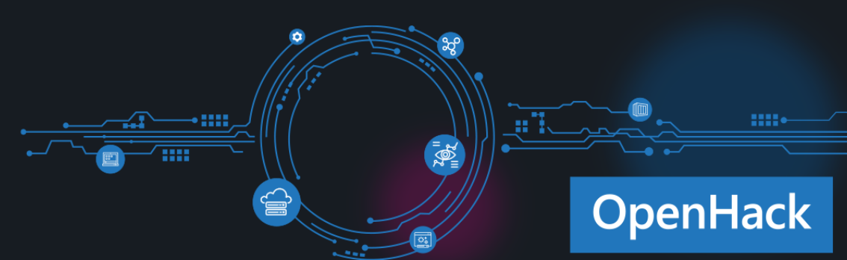


Learning path for Azure DevOps
What is DevOps?
DevOps is the union of people, process, and products to enable continuous delivery of value to our end users. Essential DevOps practices include agile planning, continuous integration, continuous delivery, and monitoring of applications.
START HERE
Short intro videos
What is Azure DevOps?
1.5 Min video
Intro to Azure DevOps
5 min video
MICROSOFT LEARN
Follow a learning path:
Or browse ala carte:
Become a Microsoft Certified Professional
Certification helps establish your credentials with current and future employers.
Try an interactive tutorial
Evolve your DevOps Practice
1hr 17 min
Getting Started with Azure DevOps
22 min
Asses your existing software development process
17 min
Create a build pipeline with Azure Pipelines
1 hr 3 min
Host your own build agent in Azure Pipelines
48 min
Implement a code workflow in your build pipeline using Git and GitHub
1 hr 13 min
Scan open source components for vulnerabilities and license ratings in Azure Pipelines
27 min
Build Applications with Azure DevOps
6 hr 10 Min
DEEP DIVE
Explore Azure DevOps Labs
Attend a DevOps OpenHack
https://www.azuredevopslabs.com/
OpenHack

